Slide 1
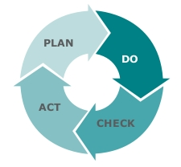
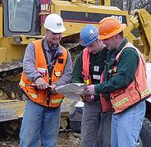
ATLANTIC COUNTY MUNICIPAL JOINT INSURANCE JUND
2017 SAFETY COORDINATORS’ ROUNDTABLE

Slide 2
2017 Safety Coordinators’ Roundtable
2016 Safety Incentive Awards
New Safety Coordinators
Resources for Safety Coordinators
Online Courses
Regional Trainings
Best Practices
Safety Committees: What’s On Your Agenda
Worker to Worker Safety Talks
PEOSH Inspections

Slide 3
2017 Safety Coordinators’ Roundtable
2016 Safety Incentive Awards
All ACMJIF Members Qualified for an Award!
X-Small $1,650.00
Small $1,900.00
Medium $2,150.00
Large $2,400.00
XL-Large $2,650.00

Slide 4
2017 Safety Coordinators’ Roundtable
2017 Safety Incentive Program
Safety Committee Schedule – January 31, 2017
2017 Safety Contract – March 31, 2017
Attend Safety Kickoff Breakfast – April 6, 2017
Attend at least One Half Day Session – Planning Retreat
(Date to be Announced)
EMS, Fire and Police Staff enroll in and complete Safe Patient Lifting for Emergency Responders online training program

Slide 5
2017 Safety Coordinators’ Roundtable
Safety Coordinators
New Safety Coordinators: Welcome to the Safety Team!
Who was a rookie Safety Coordinator in 2016?
Any tips for our new Safety Coordinators?
Advice? Suggestions?
Who are the veteran Safety Coordinators?
Any tips for our new Safety Coordinators?
Advice? Suggestions?
Notes:
Ask new Safety Coordinators what help (Documents, Coaching) did you get from your predecessor?

Slide 6
2017 Safety Coordinators’ Roundtable
Safety Coordinators Knowledge and Skills
Safety is a core value equally as important as providing cost effective and timely services to residents
Encourage safe actions and promote visible leadership
Focus on leading indicators: Job Safety Observations
Be on the lookout for risk acceptance and employees taking safety for granted

Slide 7
2017 Safety Coordinators’ Roundtable
Be sure your Toolbox Safety Talks are relevant and specific to reinforce routine jobs are hazardous…
What am I doing today?
What are today’s job hazards and risks?
What are the Safe Work Procedures and PPE for doing the job safely today?

Slide 8
2017 Safety Coordinators’ Roundtable
Safety Incentive Program
Top Down Commitment: Safety Policies/Contract
Safety Committees – Employee Representatives?
Facility Inspections
Compliance with Safety Plans and Procedures
Roadway, Signs and Walkways
PPE
Routine jobs
Job Safety Observations: Coaching & Daily Contact
Safety Training
Incident Analysis and/or Investigations
Notes:
Ask what are the two parts of Safety Training? MSI and equipment/job specific.

Slide 9
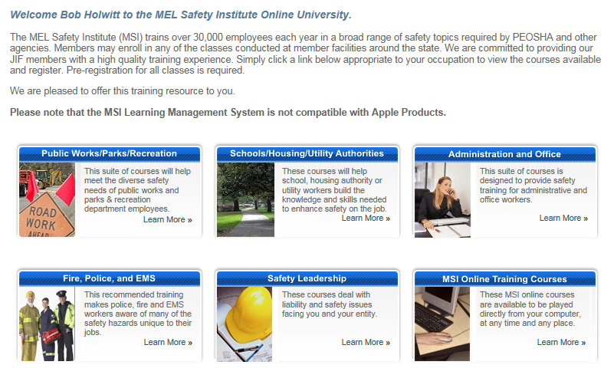
2017 Safety Coordinators’ Roundtable
Safety Resources: Online Training Programs
Notes:
The list of online courses is available when clicking on the link with approximately 20 programs.

Slide 10
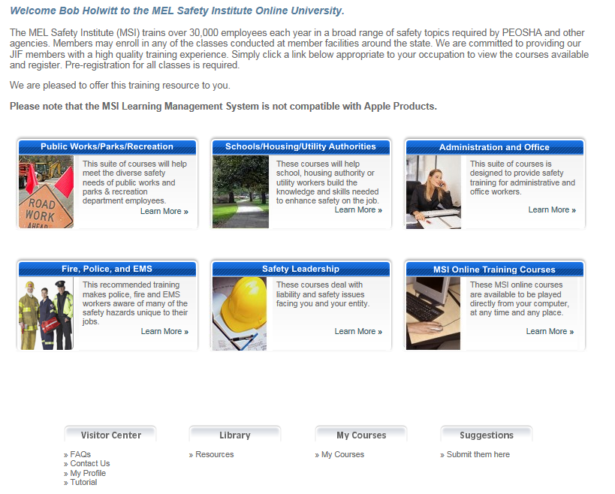
2017 Safety Coordinators’ Roundtable
Safety Resources: Online Training Programs
Use the Tutorial to Learn How to Register a Group!

Slide 11
2017 Safety Coordinators’ Roundtable
2017 ACMJIF Regional Trainings
Safety and Claims Coordinators’ Roundtable
February 9, 2017 @Merighi’s Savory Inn, Vineland NJ
Active Shooter
March 13, 2017 @Martin Luther King Center, Whitesboro NJ
Orientation of Summer Employees
Date/Location: To Be Determined
Cyber Risk Management
Date/Location: To Be Determined
Wellness Coordinator Training
Date/Location: To Be Determined

Slide 12
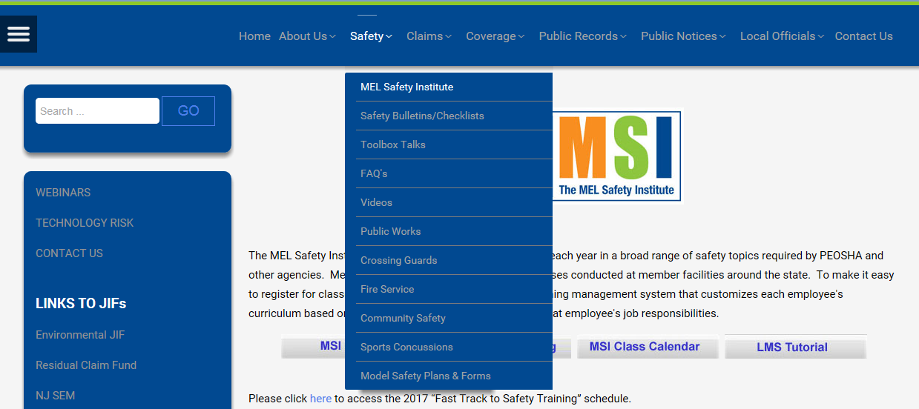
2017 Safety Coordinators’ Roundtable
Safety Resources: MSI Website

Slide 13
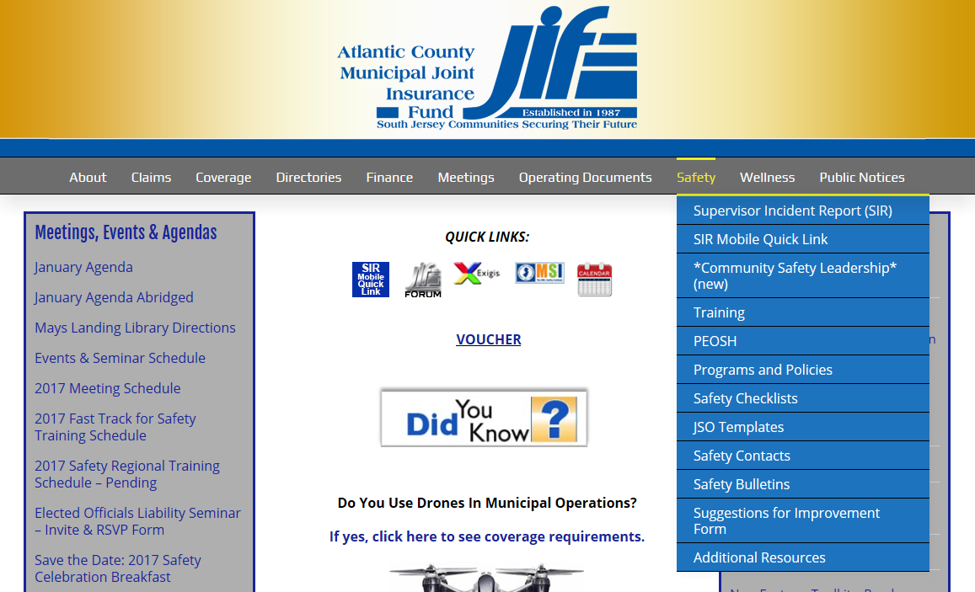
2017 Safety Coordinators’ Roundtable
Safety Resources: JIF Website

Slide 14
2017 Safety Coordinators’ Roundtable
Safety Committees: What’s On Your Agenda?
Worker to Worker: Let’s Talk Safety!
PEOSH Inspections

Slide 15
Safety Committees: What’s On Your Agenda?
1. Call to Order
Safety Tip: Be sure to start your meeting on time!
2. Roll Call
3. Introduction of Guests or Non-Committee Members
Safety Tip: If your guest is there for a presentation or other specific
reason, have them go first!
Old Business with Review of the last Safety Committee minutes
Incident Analysis
Safety Tip: Review the most recent incidents; look for contributing factors and root causes with recommendations i.e. corrective actions
Notes:
Remind Safety Coordinators about the Safety Committee fillable minutes form on the JIF website.

Slide 16
Safety Committees: What’s On Your Agenda?
New Business with Review of Latest J.A. Montgomery Loss Control Report
Safety Tip: Each member gives a short overview of their department
i.e. Fire, Police, Public Works, etc.
Training
Adjournment
Customize Your Agenda to What Works Best for You!
Notes:
When reviewing LCR, be sure to look at SFIs and action plan.

Slide 17
Worker to Worker: Let’s Talk Safety!
Constructive Worker to Worker Safety Talk Improves Safety!
Recognize the Real World Obstacles: Talking about Safety Is Difficult, We Don’t’ Know How to Do It Well and We Feel Uncomfortable Doing it!
Safety Reminder: When We See At-Risk Actions of Fellow Employees & We Don’t Speak Up, We Destroy the Value of Safety!
Recognize & Take Advantage of Every Opportunity to Talk Safety!
Willingness to Listen and Respond!
Give and Accept Safety Feedback!

Slide 18
Worker to Worker: Let’s Talk Safety!
How to Tips to Talk Safety Worker to Worker
Focus on Problem Solving and the Positive Outcomes of Talking Safety!
Focus on Actions or Situation, Not the Individual!
Start with the Positive; “I know you have done the job before, but I see an at-risk action and I want to point it out; I don’t want to see you get hurt”
Describe What You See; “The motor isn’t locked out and the job you are doing puts your hands in the line of fire”
Listen for a Response or Ask for a Response; “That’s how I see it, what about you?”
Discuss the Actions or Situation to Agree on Safety Actions; “You’re right, locking out the motor is the best way for me not get hurt!”

Slide 19
Worker to Worker: Let’s Talk Safety!
What If The Person Gets Angry or Upset? Stay Calm and Focus on Safety; Don’t Give Up and Allow the At-Risk Action to Continue!
Remember, Not Everyone Will Approach Us in the Best Way When Talking Safety! Be Sure to Look Past How the Person Talks to You and Focus on Safety and Not the Personality of Your Fellow Employee!
Don’t Prejudge Your Fellow Employee’s Unwillingness for Constructive Safety Talk! We Can’t Allow an At-Risk Action to Continue Based on How The Other Person May Respond!

Slide 20
PEOSH Inspections
Inspections Categories
Comprehensive: Substantially complete and through inspection of all potentially hazardous areas of the workplace.
Partial: Focus is limited to certain potentially hazardous areas, operations, conditions or practices at the workplace
Inspections shall be during regular business of the workplace except when special circumstances indicate otherwise
Notes:
Applicable to Department of Labor and Health; each one targets PEOSH; Labor looks at workplace safety, Health focus on Right-to-Know.
J.A. Montgomery recommends you always allow PEOSH to conduct the inspections.

Slide 21
PEOSH Inspections
Presentation of Credentials - The inspection begins with the presentation of the Compliance Safety and Health Officer’s (CSHO) credentials that include a photograph.
Opening Conference - The CSHO will describe the scope of the inspection, walk-around procedures, employee representation and employee interviews. The employer then selects a representative to accompany the compliance officer during the inspection. An authorized representative of the employees, if any, also has the right to go along. In any case, the CSHO will consult privately with a reasonable number of employees during the inspection.
Notes:
Selecting Employee Representatives Change to PEOSH
If . . . Then . . .
employees are represented by a the union will designate the employee
recognized bargaining representative, representative to accompany the CSHO.
there is a plant safety committee and the employee committee members or the
no recognized bargaining representative, employees at large will designate the employee representative.
there is neither a recognized bargaining the employees themselves may select their
representative nor a plant safety representative, or the CSHO will determine committee, if any other employees would suitably represent the interests of employees.
there is no authorized employee the CSHO must consult with a reasonable representative number of employees concerning S&H matters in the workplace. Such consultations may be held privately.

Slide 22
PEOSH Inspections
Records Review - NJOSH-300 Logs Injury and Illness for three (3) prior years
Walk-around - The CSHO and representatives will walk through the portions of the workplace covered by the inspection, looking for hazards with a likelihood of employee injury or illness.
The CSHO may interview non-managerial employees during the walk-around.
Notes:
During the walk-around, the CSHO may point out some apparent violations that can be corrected immediately. While the law requires that these hazards must be cited, prompt correction is a sign of good faith on the part of the employer.

Slide 23
PEOSH Inspections
Closing Conference – Afterwards, the CSHO holds a closing conference with the employer and the employee representatives to discuss the findings.
The CSHO describes the possible courses of action an employer may take following an inspection that could include an informal conference with PEOSH or contesting citations and proposed penalties.
The CSHO also discusses consultation services and employee rights.

Slide 24
PEOSH Inspections
Results: PEOSH may issue citations/fines; Order to Comply. The citations will describe PEOSH requirements allegedly violated, list any proposed penalties and give a deadline for correcting the alleged hazards.
Violations are categorized as willful, serious, other-than-serious, de minimis, failure to abate, and repeated.
In settling a penalty, PEOSH has a policy of reducing penalties for employers acting in good faith. For serious violations, PEOSH may also reduce the proposed penalty based on the gravity of the alleged violation.

Slide 25
PEOSH Inspections
Posting – PEOSH requires employers to post the Order to Comply immediately upon receipt by the employer. It shall remain posted until each violation has been abated or fifteen (15) working days whichever is longer.
Informal Conference - When PEOSH issues an Order to Comply, it also offers an opportunity for an informal conference to discuss citations, penalties, abatement dates or any other information pertinent to the inspection.
Employers have fifteen (15) working days after receipt of citations and proposed penalties to formally contest the alleged violations and/or penalties by sending a written notice.

Slide 26
PEOSH Inspections
PEOSH Most Frequently Cited Safety and Health Standards
Quarterly Reports
Department of Labor Workforce Development
Safety Standards: Recordkeeping, General Duty Clause, Permit Required Confined Spaces, Electrical, PPE, Hazard Communication, Emergency Action Plans, Control of Hazardous Energy, etc.
Department of Health
Health Standards: Indoor Air Quality, Asbestos, Medical Services and First Aid, Bloodborne Pathogens, Respiratory Protection, Hazard Communication, etc.
Self-Assessments/Inspections for Regulatory Compliance

Slide 27
2017 Safety Coordinators’ Roundtable
Safety and Health Websites
https://www.cdc.gov/niosh/
http://www.elcosh.org/index.php
https://www.osha.gov/
http://lwd.dol.state.nj.us/lsse/employer/Public_Employees_OSH.html
http://www.nj.gov/health/workplacehealthandsafety/peosh/
http://www.nsc.org/pages/home.aspx

Slide 28
2017 Safety Coordinators’ Roundtable
Will You Watch Out for My Safety?
Do You Want Me to Watch Out for Your Safety?
It’s The Right Thing to Do!

